Slide 1

Text Translator
Deja Carter & Zak Kafeero

Slide 2

Overview
This project is a distributed translation system designed to handle multilingual text translation efficiently. It consists of multiple servers, each dedicated to specific language pairs, running as independent processes. A multithreaded client application interacts with these servers to distribute the workload to workers for managing translation tasks concurrently.

Slide 3
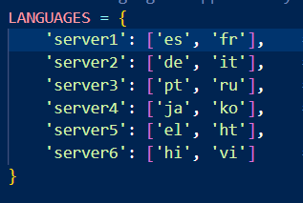
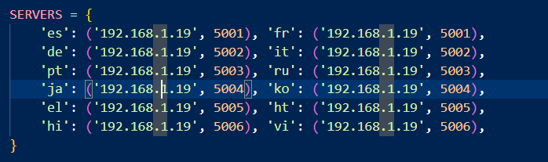
Language Servers

Slide 4
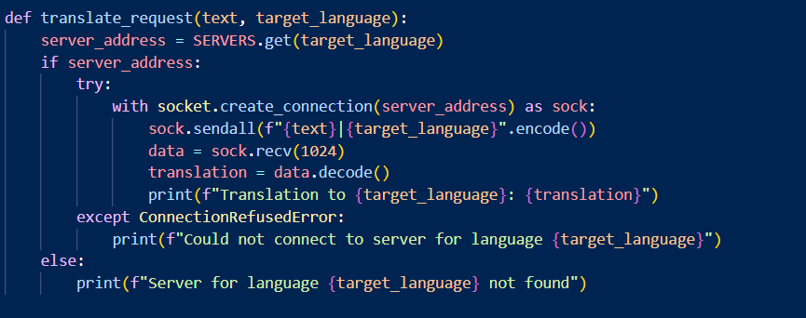
Client Code
Uses multi-threading and socket libraries
A thread is launched for each translation request to the different servers

Slide 5
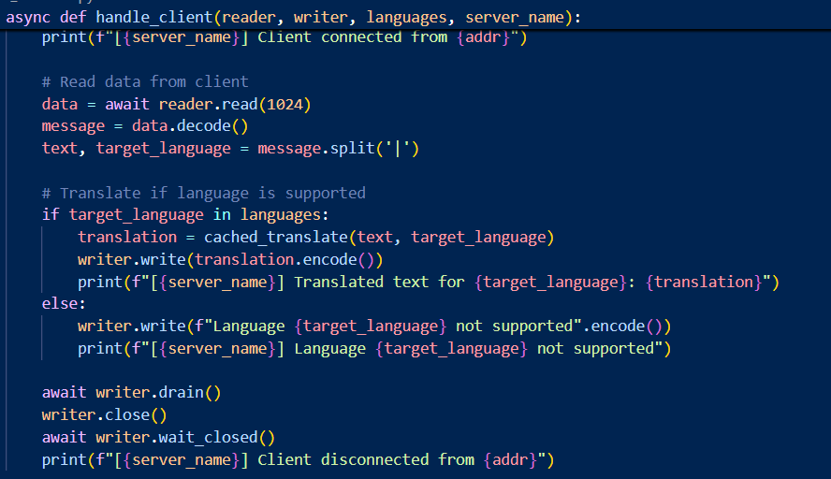
Server Code
Uses multiprocessing, functools, asyncio, and import libraries from the worker
Reads requests from the client and sends the requests to the worker
The server machine IP address is 192.168.1.19.

Slide 6
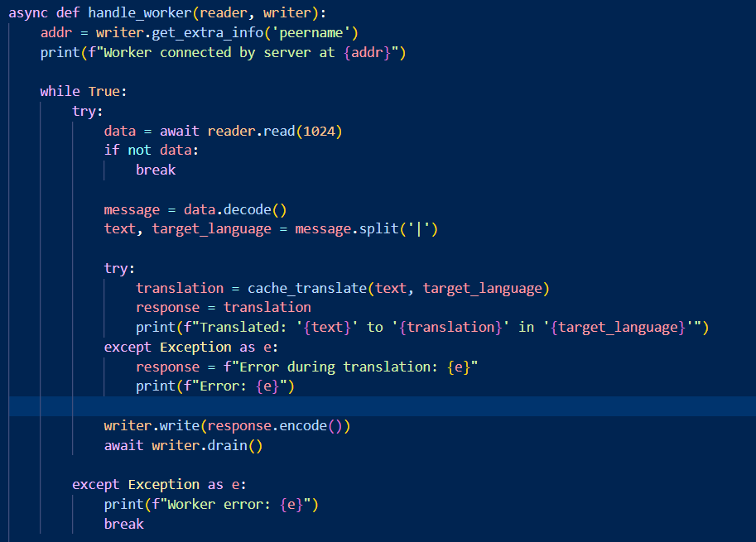
Worker Code
Uses functools, asyncio, and deep_translator libraries
Listens on a specific port and processes translation requests for assigned languages
Sends the translated text back to the requesting client

Slide 7
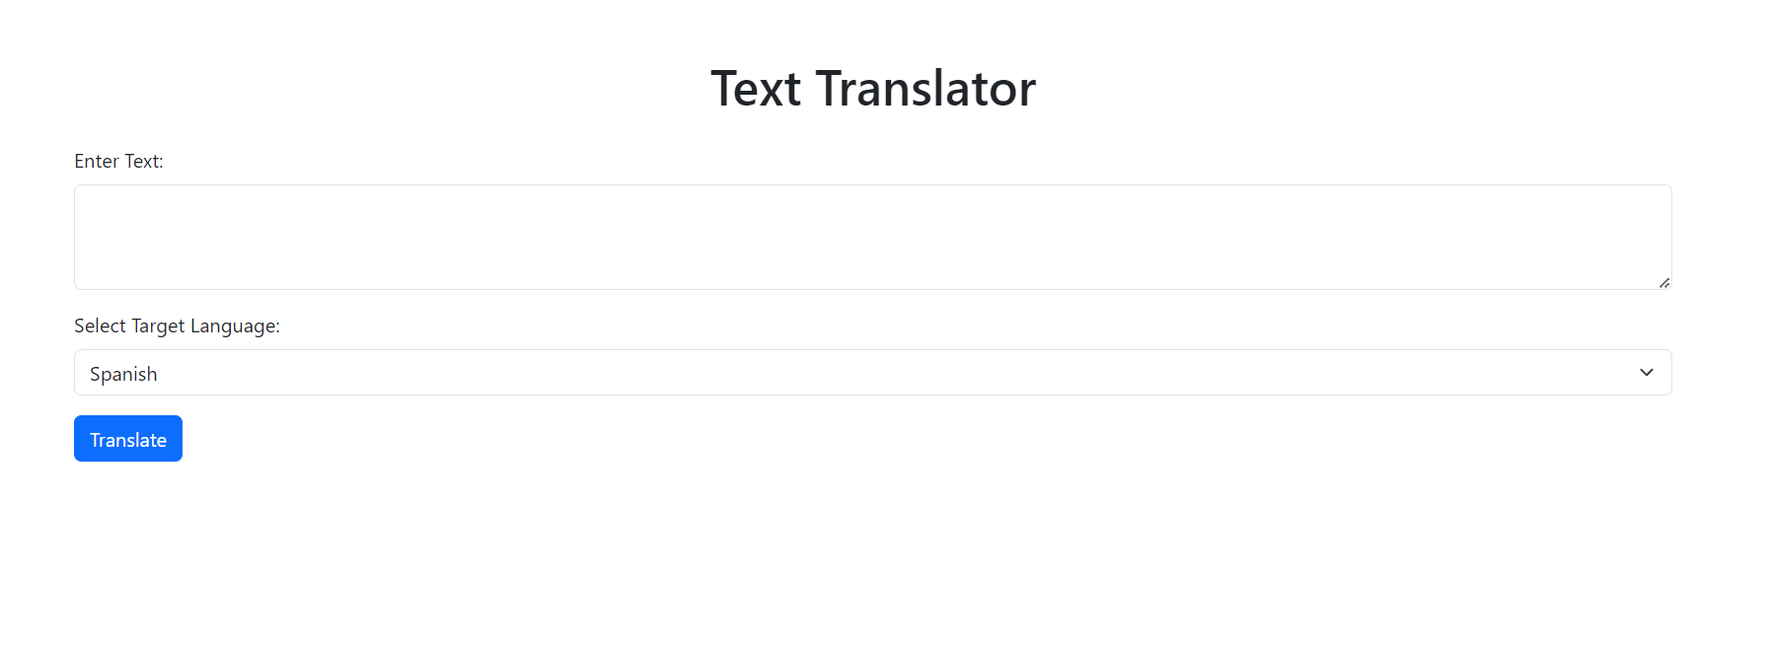
Web Interface

Slide 8
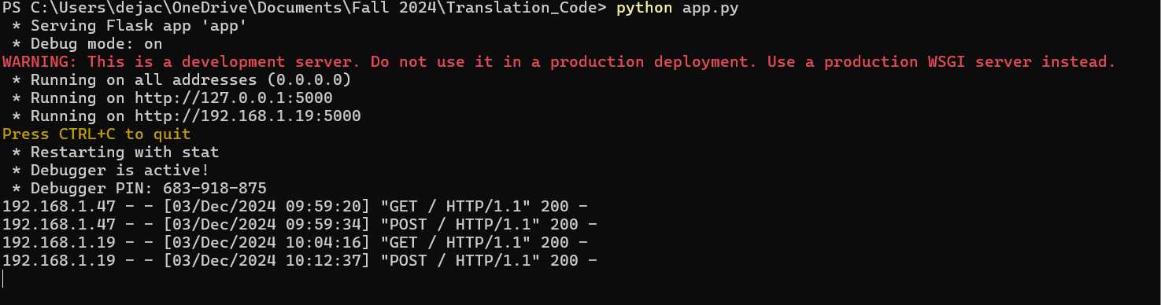
Flask Backend

Slide 9

Challenges...
Distributed Computing over Networked Machines
Server Machine Being Recognized by the Client
Verifying and Testing the Translations on Multiple Devices

Slide 10

Future Implementations
User-Friendly Design: Improve the design and usability of the web interface
Expanded Language Support: Add more languages and dialects to cater to a wider audience.
Caching: Use caching mechanisms to store frequently requested translations and reduce processing time.
Mobile App: Allow users to access translation services directly from their smartphones.

Slide 11
Any Questions?

